Slide 1
Two-Pizza Team Rule
1/16/2022 Oksana Kustova

Slide 2

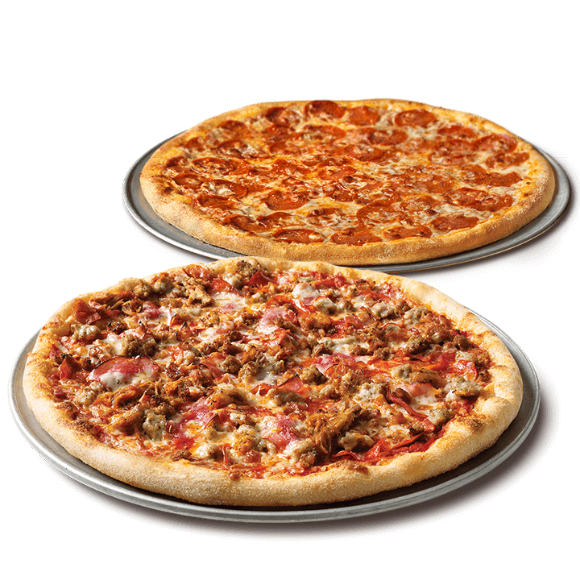
Rule Meaning
If you want to make teamwork more effective, Amazon CEO Jeff Bezos recommends using a very simple technique: the "Two Pizzas Rule.“
When you're putting together a department or group or thinking about who to invite to the next meeting, imagine how many people you can feed with two pizzas. That's how many people you should invite.

Slide 3

What is the optimal number?
When applying the Bezos approach, the number of team members is somewhere between 5 and 8. But there are other views on the problem; however, in these cases it is proposed to reduce the number of participants in one way or another.
According to Mark de Ronde, professor of strategy and organization at the University of Cambridge Business School, numerous studies show that people prefer teams consisting of four to five people. And Richard Hackman, a professor of social and organizational psychology at Harvard University, believes that it is necessary to adhere to the "less than ten" rule.

Slide 4
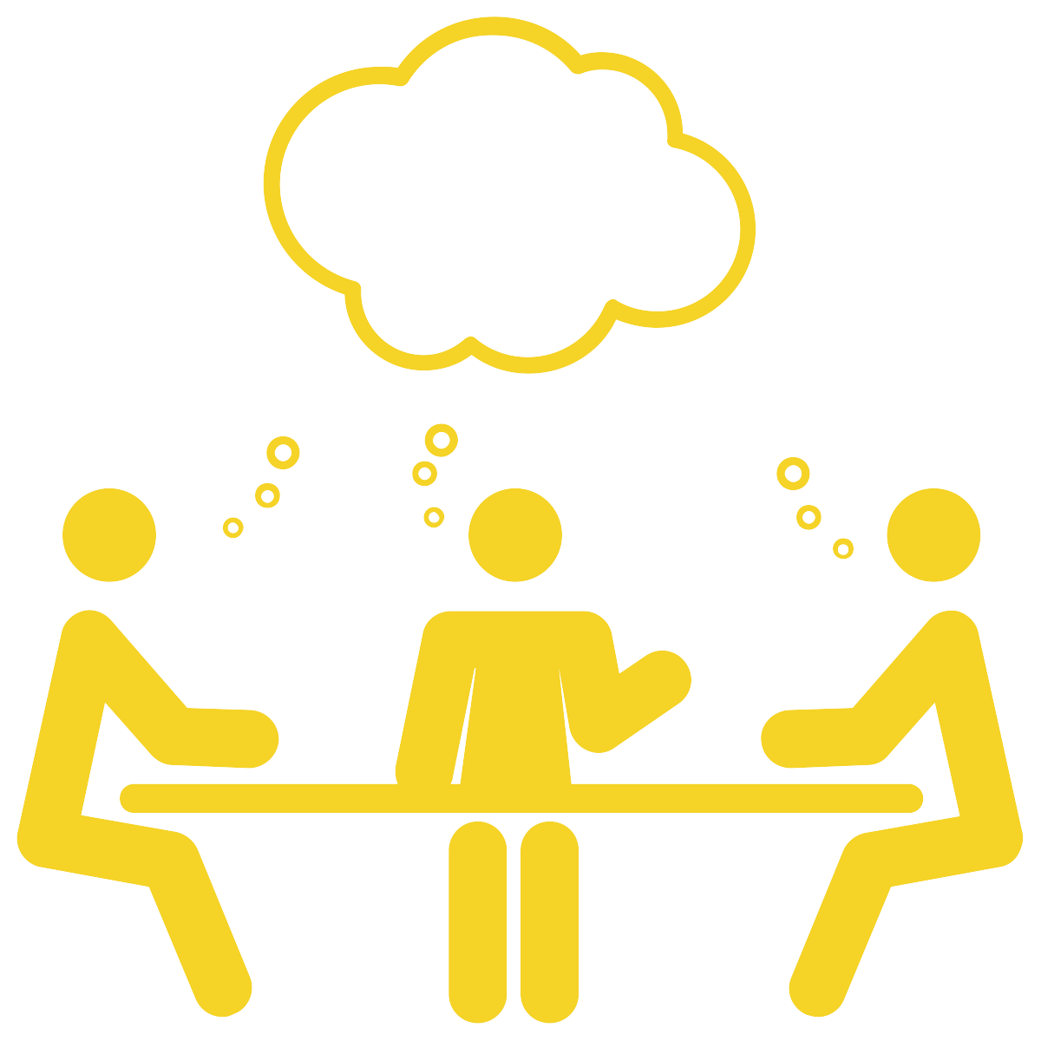
Why is less better?
Working in small teams makes it possible to eliminate such negative factors for new ideas as "groupthink" (fear of demonstrating their opinion) and "social laziness" (when people show less diligence working in a group than alone).
The latter occurs when team members feel less responsible for the final result. And "groupthink", as Psychology Today writes, takes place when the ability to move along with everyone is more appreciated in a group than to critically evaluate ideas. Bezos believes that this happens more often in large, centralized teams.

Slide 5

Why is less better?
People in numerous teams are more prone to stress. As connections accumulate in a growing team, team cohesion is lost, and it becomes increasingly difficult to get help. Careless addition of people to the team destroys the protective barrier of labor relations from stress.
It is more comfortable to be in an environment where everyone knows your name and understands what you are. This has a positive effect on productivity and motivation from day to day.

Slide 6

Why is less better?
The large size of the team makes employees arrogant. People tend to "underestimate task completion time more when the team grows," explain researchers Bradley Staats, Catherine Milkman, and Craig Fox.
In one experiment, they found that it took a team of two people 36 minutes to assemble the same Lego structure, and a team of four participants spent 52 minutes on it, which is 44% more. However, a team with a large number of participants was more confident in winning.

Slide 7
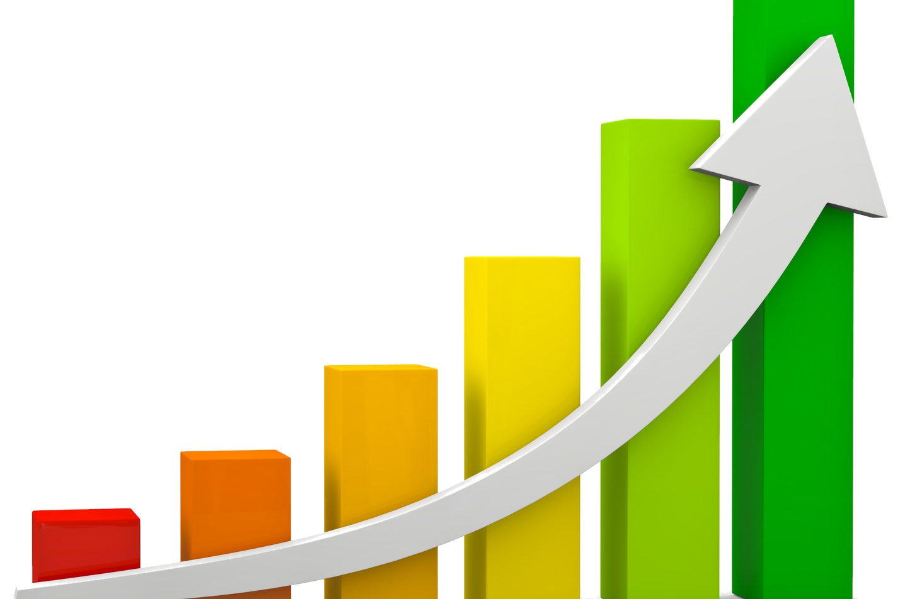
Why is less better?
There are other advantages of working in small teams: this means more effective communication, more trust between team members, less acute fear of failure, etc. The more people appear in the team, the more difficult the work process becomes.

Slide 8

What else can be done?
The stronger you unite the team, the better your team will be.
Zappos, which employs several thousand employees, devotes a lot of time to developing corporate culture and creating a family atmosphere. They even came up with a "face game" — when an employee registers in the system, another employee's face appears on the screen with brief information, whose name needs to be guessed.
A small startup Karma, following the rule of "benevolence", arranges family dinners together with the whole team every day.

Slide 9
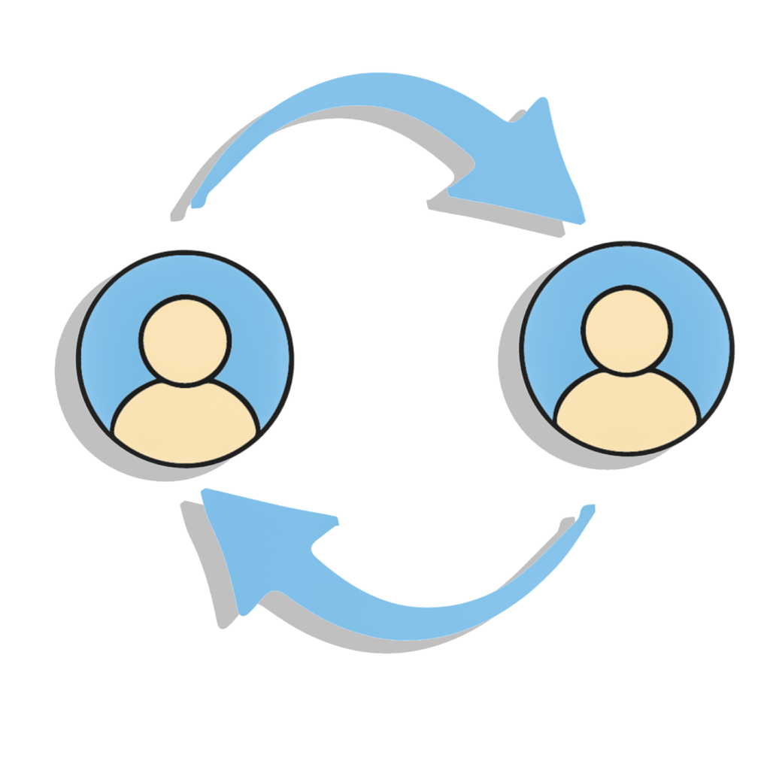
What else can be done?
According to Hackman, an expert on teamwork, one of the most important structures of effective teams is "an information system that provides participants with data and predicts their needs.
"The increase in connections between the members of the group introduces more and more misunderstandings and misinformation. Transparency through systems, processes and tools solves this problem: information is distributed evenly, colleagues are on the same wavelength and move forward together as a single team.

Slide 10
References
Choi, J., &amp; About Janet ChoiJanet Choi is the Chief Creative Officer at iDoneThis and keeps the wheels of the iDoneThis blog turning. She is not a morning person. Follow her @lethargarian or on Google+. (2020, August 21). The science behind why Jeff Bezos's two-pizza team rule works. I Done This Blog. Retrieved January 16, 2022, from http://blog.idonethis.com/two-pizza-team/ Gillett, R. (2017, May 2).
Productivity hack of the week: The two pizza approach to productive teamwork. Fast Company. Retrieved January 16, 2022, from https://www.fastcompany.com/3037542/productivity-hack-of-the-week-the-two-pizza-approach-to-productive-teamwork?partner=rss

